Slide 1
Introduction to Git
Dr. Jeroen Engelberts, Scientific Developer, Information Management and Consulting

Slide 2
Outline
Introduction IMC and Scientific Development Team
Version Control – What is it and why do I need it?
Why Git? – Git compared to other version control solutions
Working alone & together
Cloud based Git solutions
Hands-On
https://jjengelberts.github.io/eur-git-101
Questions & Answers

Slide 3
IMC – Information Management & Consulting
Consultancy
Functional Application Management
Learning & Innovation Team
IT Development
Web Development
Scientific Development
Govert Buijs, Erik Kemperman, Paul Kievits and Jeroen Engelberts
Email: scidev@rsm.nl
Telephone: 010-4081930
Location: Mandeville (T) 06-13

Slide 4
Version Control – What & Who?
What is version control?
“Version control is a system that records changes to a file or set of files over time so that you can recall specific versions later.” [Pro Git, Apress, 2nd – 2014, Scott Chacon, Ben Straub]
Who should use, or who could benefit from version control?
Any software developer
Anyone writing a bunch of articles, like a PhD thesis ☺
Any group of people working together with many (text) files

Slide 5
Version Control – Why?
Advantages
Differences over time can be reviewed easily
Changes can be unrolled
It enables concurrent working on the same files
Changes are linked to individuals
Logging is kept (metadata) for each change
Date
Time
Description

Slide 6

Local Version Control System
Pro
Version control!
Cons
Single user
Limited collaboration

Slide 7
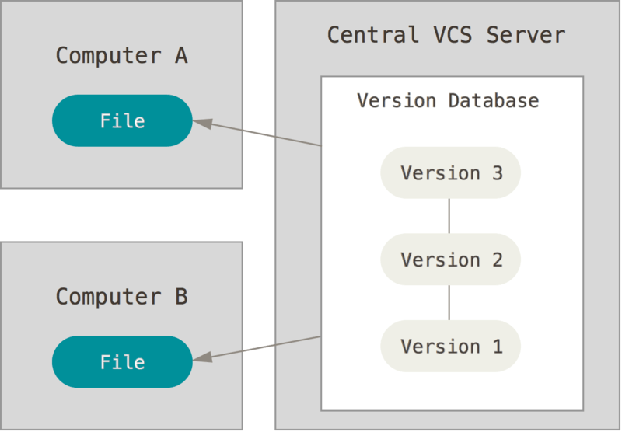
Centralized Version Control System
Pros
Version control!
Multiple users
Collaboration
Cons
Revisions not local
Merging can be challenging

Slide 8
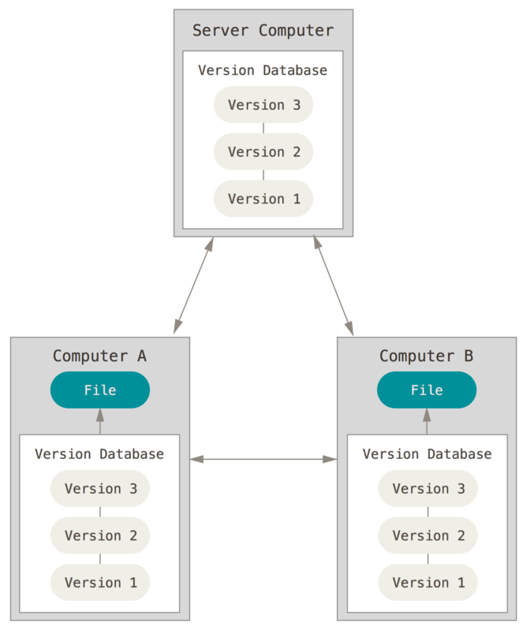
Distributed Version Control System
Pros
Version control!
Multiple users
Collaboration
Revisions are locally cloned
Con
Merging complete branches can hard or even impossible

Slide 9

Online Git services
GitHub: http://www.github.com
Bitbucket: http://www.bitbucket.com
GitLab: http://www.gitlab.com
Coding: http://coding.net (Chinese only)
NB The Erasmus University has its own Bitbucket instance:
http://stash.ict.eur.nl
(login with your ERNA-id)

Slide 10
Hands-On Guide
Hands-On guide can be found here:
→ https://jjengelberts.github.io/eur-git-101
It covers:
Installation of Git 2.18.0 on @wEURk desktop/laptop
Cloning an existing repository (from Github)
Opening an existing local repository
Creating a new local repository
Using Tags and Branches

Slide 11

Questions and Answers

